Slide 1

Customer success
Monthly support report
Lazar Milicevic
Key metrics, achievements, roadmap & next steps
September 2025

Slide 2
Agenda
1
Part I: Abstra support key metrics
2
Part II: Achievements & roadmap
3
Part III: Roadmap items
deep dive
4
Part IV: Product Insights
5
Part V: Next steps

Slide 3
Executive Summary
Customer success: Monthly Support Report - September 2025
Metrics summary:
▶ 119 tickets handled in September (+85.9% vs August), reflecting increased workload from external Abstra users and SageMaker-related maintenance.
▶ First response time averaged 41 minutes (+95%), still well below SLA (<2h) despite higher volume.
▶ Average resolution time improved to 11.5 hrs (–37%), confirming better triage and workflow prioritization.
▶ CSAT at 93.3% (+3.7%), maintaining strong user satisfaction through higher ticket volume.
▶ Blocking issues stayed low (7 cases, all within SLA), showing stable platform performance
Zendesk & Process Improvements
▶ Implemented new forms, triggers, and auto-assignment rules, with most tickets now funneled through Zendesk.
▶ Automated workflows reduced manual triage and improved ownership visibility across squads.
▶ Continued user redirection from Slack to Zendesk to consolidate all support interactions.
▶ Planned IT Support / IT Office onboarding to achieve full organizational adoption.
→ TL;DR – In September, we finished the Cognito → PostHog backfill, making PostHog the central source for support analytics.
Zendesk operations were further automated through new forms, triggers, and ownership logic, improving visibility and SLA performance.
Together, these updates established a fully connected analytics and support ecosystem, setting the stage for CloudTrail integration and automated KPI reporting in October.
Owkin K
▶ Successfully completed Cognito → PostHog historical backfill (1,146 validated users, 0 duplicates, 11 batches).
▶ All key metrics (D1/D7 retention, DAU/WAU, SLA trends) are now live and tier-segmented (K-Pro / K-Navigator).
▶ PostHog established as the central analytics platform for Support, Product, and Engineering.
▶ Initiated CloudTrail integration to enrich the dataset with confirmation timestamps.
▶ Prepared for automated KPI reporting (Notion & Slack) and alert-based SLA dashboards in October..

Slide 4

Agenda
1
Part I: Abstra support key metrics
2
Part II: Achievements & roadmap
3
Part III: Roadmap items
deep dive
4
Part IV: Product Insights
5
Part V: Next steps

Slide 5
Abstra at a glance - Fullstory Metrics
Customer success: Monthly Support Report - September 2025
A general overview of numerical metrics and feature adoption compared with previous month
General Metrics
Catalog Metrics
Slide Viewer Metrics
Other Metrics
Active Users
124
-35.1%
Dataset Search
605
-38.6%
Users
47
-27.7%
Target Directory Users
8
-33.3%
New Users
6
0.0%
Dataset Views
2634
-31.5%
Sessions
323
-23.3%
Average session
per user
23
-3.3%
Abstra
Documentation
20
+10%

Slide 6
Key metrics overview
Customer success: Monthly Support Report - September 2025
August
September
Change
General monthly key metrics
Tickets Received
64
119
+85.94 %
September showed a significant increase in ticket volume compared to August, mainly driven by a higher number of external Abstra users, ongoing maintenance work on the Abstra platform, and an increased flow of technical requests related to SageMaker and Workspace environments.
Despite the increased workload, overall efficiency improved — resolution times shortened, and satisfaction slightly increased, confirming stable performance and strong process control across the support team. 📈 119 tickets received — an +85.94% increase vs. August, showing a clear growth in handled workload with no drop in service quality.
✅ 91.6% solved rate, a major improvement over August (78.1%), demonstrating excellent team responsiveness and collaboration.
⚡ 41 min average first response time, a +95.24% increase, reflecting slightly slower first response,, but still well within SLA (<2h).
⏱ 11.5 hrs average full resolution time, a –37.16% decrease, showing faster resolution cycles and improved issue prioritization.
😊 93.3% CSAT, a +3.67% improvement, maintaining strong user sentiment and confidence in the support experience.
Solved/Received
78.1%%
78.1%
+91.6 %
Average First Response Time (Bus. hrs.)
21 min
41 min
–95.24 %
Average Full Resolution Time (Bus. hrs.)
18.3 hrs
11.5 hrs
–37.16 %
% Satisfied CSAT
90%
93.3%
+3.67 %
*Times are in business hours.
Key Observations:
✅ Ticket volume increased notably (+85.9%) due to a surge in external Abstra users, ongoing maintenance work on the Abstra platform, and multiple SageMaker and Workspace–related requests.
Despite this, response quality and workflow stability were fully maintained.
⚙️ Solved rate reached 91.6%, marking a strong improvement compared to August (78.1%), highlighting effective prioritization and enhanced team coordination during higher workload periods.
⏱ Average full resolution time dropped by 37.16%, showing more efficient ticket handling and better triaging across complex technical cases.
💬 Average first response time increased to 41 minutes, reflecting higher volume but still remaining well within SLA thresholds (<2h).
😊 User satisfaction (CSAT 93.3%) improved by +3.67%, confirming consistently high service quality and positive user perception of support interactions.

Slide 7
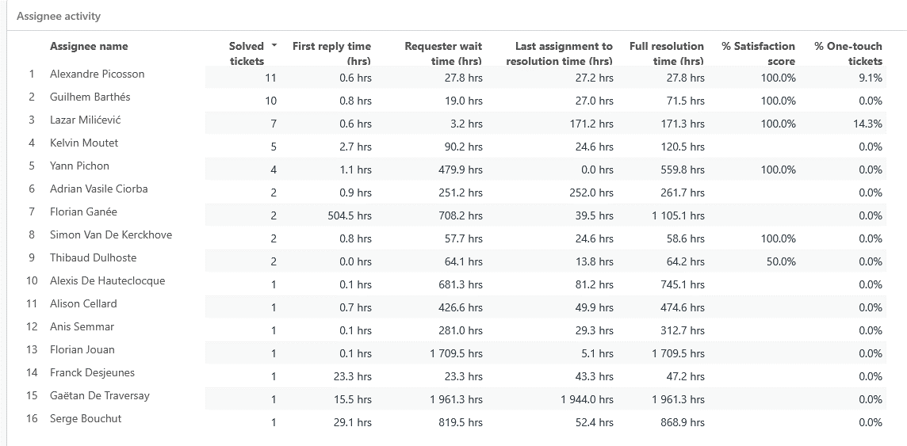
Monthly Ticket Counts & Average Resolution Times
Customer success: Monthly Support Report - September 2025
Compared with previous 3 months
2025
Tickets Received
Avg. Full Resolution Time
June
83
1.1 hrs
July
62
1.3 hrs
August
64
18.3 hrs
September
119
18.3 hrs
*Times are in business hours.
September Summary
✔️ 119 tickets – sharp increase of +85.9%, mainly due to more external Abstra users, maintenance activities, and higher SageMaker/Workspace requests.
✔️ 41 min FRT – slight slowdown (+95.2%) vs. August, but still well within the 2h SLA target.
✔️ 11.5 hrs resolution – strong improvement (-37.2%) reflecting faster triaging and resolution efficiency.
✔️ 93.3% CSAT – solid +3.67% increase, confirming high user satisfaction and service consistency.
We remain focused on balancing complex request handling with responsiveness as internal demands evolve.

Slide 8
Blocking issues key metrics overview
Customer success: Monthly Support Report - September 2025
Monthly metrics and changes for the reported blocking issues
Blocking issue volume increased in September, with 7 reported cases compared to 4 in August (+75%), mainly due to a few new external user incidents and maintenance-related blockers. Despite this, the overall frequency of blocking issues remained low and well-controlled.
Overall resolution performance showed strong improvement:
⚡ First response times improved to 0.1 hrs (–50%), ensuring rapid acknowledgment and engagement for critical incidents.
⏱ Average resolution time decreased to 8.4 hrs (–54.35%), reflecting more efficient triaging and faster follow-up cycles compared to August.
All blocking tickets were resolved well within SLA limits, confirming solid coordination across the engineering and support teams.
We continue to monitor and refine early detection of blocking issues, applying lessons from August to enhance prioritization, routing, and escalation workflows for future cases.
August
September
Change
Tickets Received
4
7
+75.00 %
Solved
4
7
0%
Average First Response Time (Bus. hrs.)
0.2 hrs
0.1 hrs
–50.00 %
Average Full Resolution Time (Bus. hrs.)
18.4 hrs
8.4 hrs
–54.35 %
*Times are in business hours.

Slide 9
Number of tickets received per topic
Customer success: Monthly Support Report - September 2025
Increasing tickets related to Project Creation as well as SageMaker issues.
September showed a visible rise in recurring technical topics, with SageMaker remaining the dominant source of requests. Compared to August, developer environment and workspace-related issues increased, while onboarding and project-creation requests slightly decreased.
📌 The most notable trends this month include:
✔️ 10 tickets related to SageMaker – continued demand for troubleshooting, training environment setup, and runtime support.
✔️ 7 tickets for enabling CI access to CodeArtifact registry – higher developer activity and configuration requests across multiple users.
✔️ 6 tickets under Other – mixed category, covering internal tool issues and general platform maintenance.
✔️ 6 tickets related to Workspace not starting – recurring environment initialization or dependency-related blockers.
✔️ 5 tickets requesting the creation of a new Abstra project – slightly lower onboarding activity compared to the previous month.
Topic
Tickets
SageMaker Issues
10
Allowing CI to access codeartifact package registry
7
Other
6
Workspace::Workspace is not starting
6
Create a new Abstra Project
5
Notes:
rank by desc order

Slide 10
Trend in topics received compared with previous month
Customer success: Monthly Support Report - September 2025
Highest changes in number of tickets received per topic
August
September
Change
September ticket trends showed a sharp rise in several technical topics, driven by increased developer activity and higher environment troubleshooting demand compared to August. SageMaker remained the most frequent category, while CodeArtifact and project-creation requests grew significantly.
● “Other” requests grew by +500%, reflecting a spike in miscellaneous and internal tool support cases.
● SageMaker Issues increased by +11.1%, confirming continued demand for environment setup and training support.
● New Abstra Project requests rose by +400%, indicating renewed onboarding activity and project creation across user teams.
● Workspace-related tickets decreased by −14.3%, showing a moderate drop in environment startup issues after recent platform stabilizations.
● CodeArtifact CI access requests surged by +700%, marking a strong return of developer-pipeline configuration activity compared to August.
Other
1
6
+500.00 %
SageMaker Issues
9
10
+11.11 %
Create a new Abstra Project
1
5
+400.00 %
Workspace::Workspace is not starting
7
6
−14.29 %
Allowing CI to access codeartifact package registry
0
7
700.0%

Slide 11
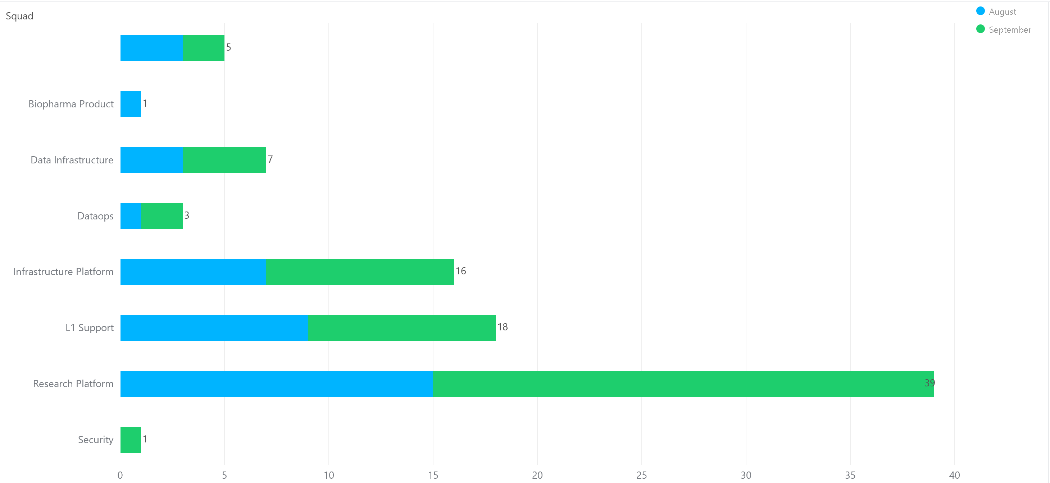
Tickets per squad
Customer success: Monthly Support Report - September 2025
Month-over-Month (MoM) Overview for ticket counts per squad
Owkin K Support processed 22 tickets, remaining the most active squad and managing the majority of day-to-day operational and signup-related requests.
Research Platform squad handled 39 tickets, showing a slight decrease from August (41) but still leading in experimentation workflows and advanced tooling support.
L1 Support processed 18 tickets, continuing to play a pivotal role in triaging and onboarding new users while maintaining quick turnaround and consistent first-line coverage.
Infrastructure Platform handled 16 tickets, reflecting a steady rise from August (13) and sustained demand for AWS configuration and internal environment management.
Data Infrastructure managed 7 tickets and Data Content 8 tickets, addressing onboarding and data-pipeline configuration topics.
Biopharma Product squad processed 1 ticket, while DatOps handled 3, both representing low but specialized support activity.
Security and Solution Architecture squads each managed 1 ticket, confirming their continued involvement in niche technical and access-control requests.

Slide 12
Help Center article views - August 2025
Customer success: Monthly Support Report - September 2025
Most viewed help center articles in the month
Top articles viewed this month:
Owkin K - Brand
Abstra - Brand
Article
Views
Article
Views
Owkin K User Guide: Getting started
149
My workspace is not starting
3
Owkin K User Guide: Available plots
83
"Access Denied" when uploading data into a dataset
2
What is the list of public and private datasets available in Owkin K Navigator?
30
"HOME PARTITION FULL" warning message
2
Owkin K User Guide – Available data
28
My workspace has disappeared
2

Slide 13


🏆
Superstar of the month!
Part title
Damien Vergnaud
For having the least first response time of 0.01
business hours
Alexandre Picosson
Handling most number of L2 tickets

Slide 14

Agenda
1
Part I: Abstra support key metrics
2
Part II: Achievements & roadmap
3
Part III: Roadmap items
deep dive
4
Part IV: Product Insights
5
Part V: Next steps

Slide 15
Customer success roadmap timeline
Customer success: Monthly Support Report - September 2025
Main topics we aim to achieve through Q3/Q4 -25.
August
September
October
Collaborate with Product team on feedback loops and implement structured feedback collection after PostHog dashboard's launch
Finalize PostHog dashboard iterations , regroup widgets, optimize KPI labels, and integrate histograms for key metrics.
Complete Cognito backfill to PostHog, align distinct_id mapping, and validate first production import for full user coverage.
Launch tier-segmented PostHog dashboards, track signup funnel, retention (D1/D7), DAU/WAU, and validate KPI widget accuracy.
Develop an internal triage playbook for new support agents, to standardize L1/L2 responses and reduce ramp-up time.
Implement automated KPI reporting in Notion & Slack
Roll out new Zendesk automations and playbook, including Pending→Open trigger, to maintain <30 min FRT at scale.
Finalize the 3rd phase of the Cognito → PostHog backfill by extracting ConfirmSignUp events from CloudTrai
Completed Cognito → PostHog historical backfill, successfully importing 1,146 users across 11 validated batches with zero duplicates.
Initiated Phase 3 (signup_confirm_successful event) development for posthog backfiling.
Launched tier-segmented PostHog dashboards (K-Pro / K-Navigator) with verified D1/D7 retention, DAU/WAU tracking, and KPI widget calibration.
Improved Zendesk operational metrics — maintained < 1 hr average resolution for blocking issues and > 93 % CSAT satisfaction.
Expanded cross-team collaboration between Product, Data Infrastructure, and Support squads to align PostHog metrics with platform KPIs.
Laying the foundation for Ocober: full Cognito backfill, CloudTrail integration planning, and scalable automation across PostHog and Zendesk systems.

Slide 16
Agenda
1
Part I: Abstra support key metrics
2
Part II: Achievements & roadmap
3
Part III: Roadmap items
deep dive
4
Part IV: Product Insights
5
Part V: Next steps

Slide 17
Customer success Q3 Roadmap items (RIs)
Customer success: Monthly Support Report - September 2025
01
Zendesk – Focal point for all support requests
02
K - Navigator - Launch internal support playbook for new agents, including L1/L2 triage flows, escalation steps, and ticket classification guidance.
+ Finalize PostHog dashboard setup to support proactive SLA monitoring and UX friction analysis, ensuring data-driven improvements in triage efficiency.
03
Maintain first response time under 20 minutes for both Abstra-related and Owkin K tickets

Slide 18
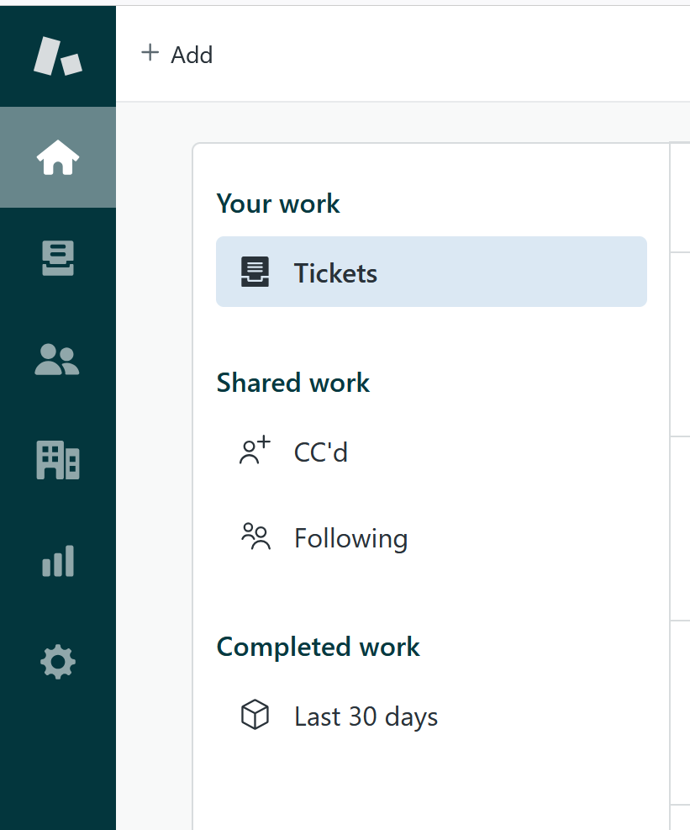
RI#1: Zendesk – Focal point for all support requests
Customer success: Monthly Support Report - September 2025
By the end of September, significant progress was made — with new forms, triggers, and auto-assignment rules implemented, a growing majority of support requests are now funneled through Zendesk.
Some messages still come via Slack, but we continue to encourage users to create tickets to maintain a centralized workflow.
The IT Support / IT Office team remains the main group not yet fully onboarded, which we aim to include soon.
These improvements should improve visibility, ownership clarity, and overall support consistency across teams.

Slide 19
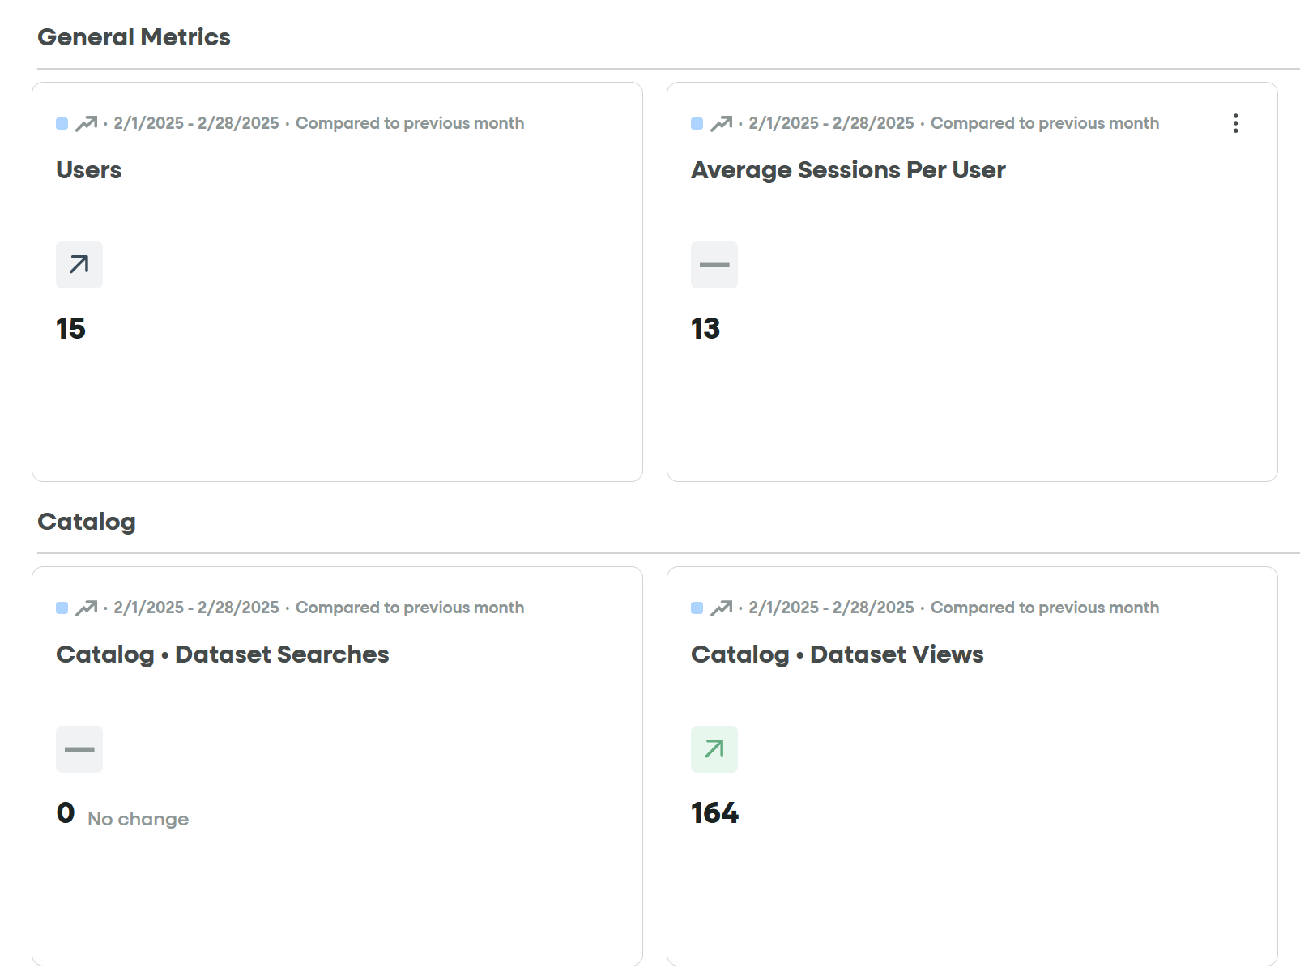
RI#2 PostHog Analytics Rollout for Support Operations
🚀 RI#2 – PostHog Analytics Rollout for Support Operations
Objective
Establish a unified analytics framework in PostHog to deliver real-time visibility on support activity, SLA performance, and user engagement across K-Navigator.
Progress & Achievements (September)
The initiative was successfully completed this month.We finalized the Cognito → PostHog historical backfill, importing 1,146 validated users across 11 clean batches with zero duplicates.All key signup and retention metrics (D1/D7, DAU/WAU) are now live and segmented by tier (K-Pro / K-Navigator).Dashboards were expanded to include SLA tracking, ticket resolution times, and conversion funnel insights, giving full visibility across the support lifecycle.PostHog now serves as the single source of truth for operational analytics, replacing manual tracking in FullStory and SurveySparrow.
Next Steps:
→ Integrate CloudTrail confirmation timestamps to complete the signup confirmation dataset (signup_confirm_successful event).
→ Automate weekly KPI reporting to Notion and Slack for real-time visibility.
→ Introduce alert-based dashboards for SLA breaches and ticket volume spikes.
Impact
→ 100 % coverage of all historical user signups in PostHog
→ Consolidated reporting and analytics workflows, reducing tool switching.
→ Unified analytics for Product, Support & Engineering teams.
Customer success: Monthly Support Report - September 2025

Slide 20
Agenda
1
Part I: Abstra support key metrics
2
Part II: Achievements & roadmap
3
Part III: Roadmap items
deep dive
4
Part IV: Product Insights
5
Part V: Next steps

Slide 21
Next steps for Customer Success
Customer success: Monthly Support Report - September 2025
Deliver excellent customer service
→ Maintain <30 min first response time for all requests with better triage priorities.
→ Resolve promptly signup access requests and streamline VPN clarifications for external Abstra users.
→ Continue direct Slack/Zendesk support for real-time troubleshooting and user onboarding assistance.
Strengthen Zendesk Operations
→ Deploy new Zendesk automations (Pending ↔ Open trigger, auto-assignment, and closure logic) to further reduce manual handling.→ Begin onboarding IT Support / IT Office into Zendesk to unify all support channels under one system.
→ Monitor FRT and SLA metrics post-automation rollout to ensure stability and <30 min response time target.
→ Update Internal Support Playbook to reflect new routing logic and ticket form changes.
Please do not hesitate to reach out to me for any questions.
Operationalize Insights to Improve Onboarding Experience
→ Integrate CloudTrail confirmation timestamps into PostHog to complete the user funnel dataset (signup_confirm_successful).
→ Launch automated KPI reporting to Notion and Slack for weekly visibility of CSAT, SLA, and ticket metrics.
→ Enhance PostHog dashboards with live event data for real-time tracking of onboarding friction and resolution trends.
→ Collaborate with Product to align analytics insights with UX form adjustments and optimize user journeys across Abstra and K-Navigator..

Slide 22
Agenda
1
Part I: Abstra support key metrics
2
Part II: Achievements & roadmap
3
Part III: Roadmap items
deep dive
4
Part IV: Product Insights
5
Part V: Next steps

Slide 23
Thank you!

